Slide 1

CloudBox: Cloud File Storage System
A simple overview of a browser-based file storage app powered by AWS S3
PRESENTED BY:
KUNCHAM VARAHA VENKATA SUPRIYA CHEERALA KONA HIMA BINDHU PULAVARTHI GAYATRI
MADDILA POOJA SIRIVARSHINI PIDUGU DEEKSHITHA

Slide 2

Cloud Storage Overview
11
What Cloud Storage Enables
Store, organize, and access your files from one online place.
Manage content anytime using a simple web interface.
Core User Actions
Upload and download files directly to cloud storage.
Create folders and keep files organized in a clear structure.
Security and Reliability
Accounts are protected with JWT login and password hashing.
Cloud storage improves availability and reduces risk of losing data.

Slide 3



Everyday file organization
02
Why CloudBox Matters
Keep files and folders in one place, ready to find and share.
Use a simple web interface that feels familiar to most users.
Built for secure access
User accounts help ensure only the right people can access content.
Sharing links make collaboration possible without exposing everything.
Fast, efficient file handling
Files transfer directly between the browser and cloud storage.
This avoids routing large files through the backend server.

Slide 4



Local storage is risky
04
Problem With Local Files
Files can disappear if a phone or laptop is lost or damaged.
Device crashes can wipe important documents without warning.
Access is limited
Your files are not easily available across different devices.
Managing files is frustrating
Keeping folders organized locally becomes harder over time.
People need a simple, safe place for important files.

Slide 5




System Workﬂow
04
User-to-app interaction
Users work in the browser through a simple web interface.
The frontend handles screens and actions without heavy setup.
Backend coordinates logic
An Express API verifies sign-ins and authorizes each request.
It tracks folders and file details as metadata in a database.
Direct file transfer to S3
Uploads and downloads go straight between browser and AWS S3.
Pre-signed links enable faster transfers and less server load.

Slide 6



Core User Actions
03
Account access
Users can register and log in with JWT-based sign-in.
Everyday file actions
Upload and download files through the web interface.
Rename, delete, and create share links when needed.
Folder organization
Create, rename, and remove folders to keep content tidy.
Store items in nested folders for clearer structure.

Slide 7

Core Tech Stack
05
Frontend
Built with HTML,
CSS, and JavaScript for a lightweight web experience.
Backend API
Node.js and Express power REST endpoints
for app functionality.
Data & storage
SQLite stores file metadata, while AWS S3 stores uploaded files.
Why this stack works
Simple to deploy and maintain,
while supporting core storage needs.

Slide 8


Security Approach
06
Protected account access
JWT login tokens help ensure only signed-in users reach their files.
Safer credential handling
Passwords are stored using hashing, reducing risk if data is exposed.
Controlled file transfers
Pre-signed URLs allow time-limited uploads and downloads to S3.
Less stored on the server
Backend keeps metadata only, while file contents stay in S3.

Slide 9

App Folder Layout
07
Backend folder
Holds API routes, middleware, database setup, and server startup code.
Includes AWS S3 helper logic for generating pre-signed links.
Frontend folder
Contains the main pages (index and sharing page) users open.
Includes configuration, styles, and JavaScript for the UI.
Why the split helps
Keeps user interface and server logic separate for easier updates.

Slide 10

Live Deployment
08
Live access
The frontend is hosted on Netlify, so anyone can open it in a browser.
API availability
The backend REST API runs on Render to handle app requests reliably.
End-to-end deployment
Together, Netlify and Render demonstrate a complete, working cloud app setup.

Slide 11



Roadmap Highlights
09
Product upgrades
Add fast file search and in-browser previews for common formats.
Introduce file versioning so users can restore older edits.
Create a recycle bin to recover accidentally deleted items.
Sharing and uploads
Support share links that automatically expire for safer access.
Enable drag-and-drop uploads to reduce steps and save time.
Bigger-picture takeaway
These enhancements build on a solid base for scalable storage.

Slide 12
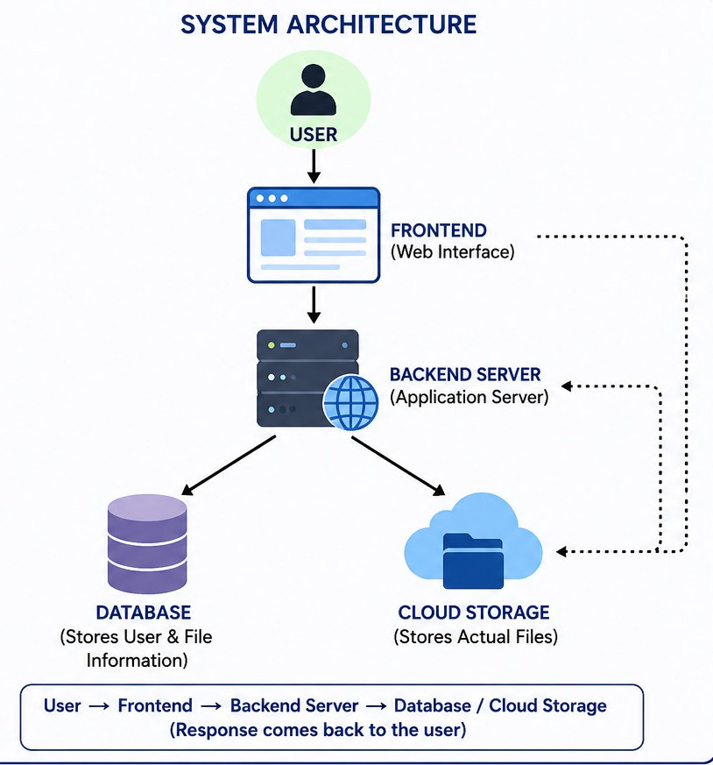
System Architecture
10
The Cloud Storage System follows a client-server architecture.
The user accesses the application through a web browser.
The frontend sends the user's requests to the backend server.
The backend verifies the user, processes the request, stores file information in the database, and uploads the actual files to cloud storage. The response is then sent back to the user.
Components:
User: Uses the application through a web browser. Frontend: Receives user actions and sends requests.
Backend Server: Processes requests and manages authentication. Database: Stores user details and file metadata.
Cloud Storage (AWS S3): Stores uploaded files securely.
Flow:
User → Frontend → Backend Server → Database + AWS S3 → Response to User

